Slide 1
Using Alexa with Flask-Ask
Josh Knox – Kinney Group
March 13, 2018

Slide 2


Slide 3
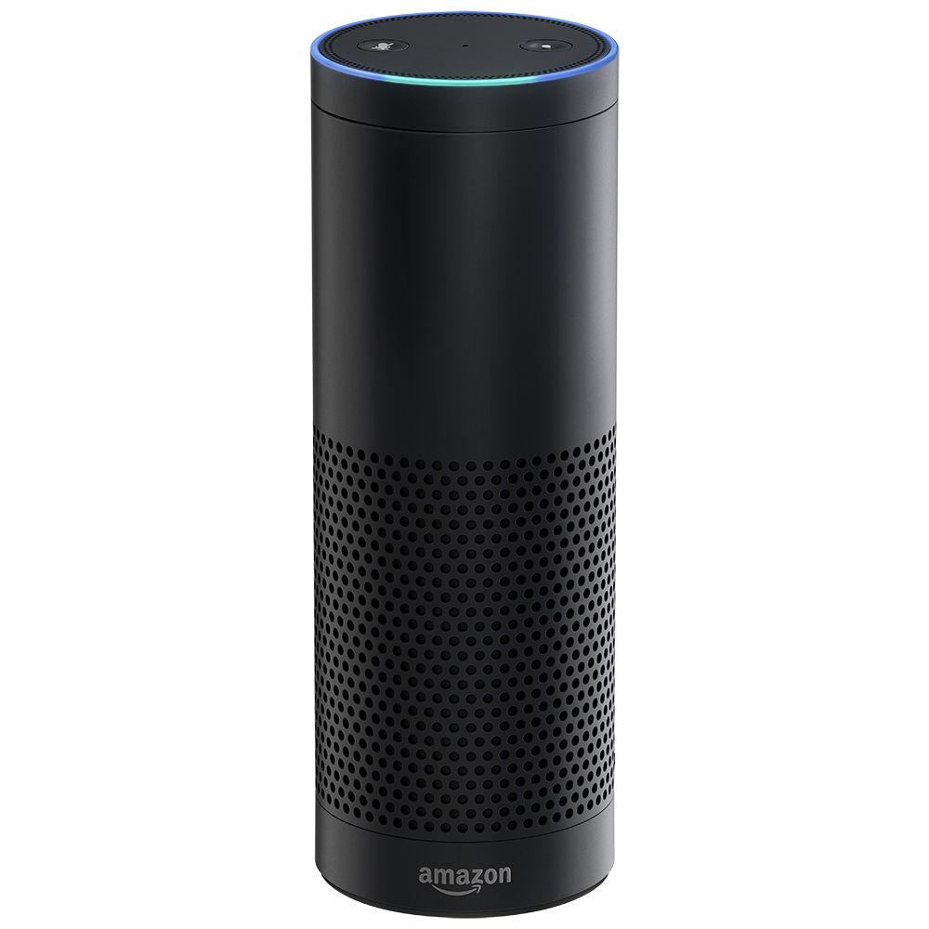
Introduction
Alexa – Let’s make an app!
Original Use Case:
Use Alexa to talk to IT Infrastructure
VMware
Splunk
Expanded Use Case:
What else can I control with it?

Slide 4
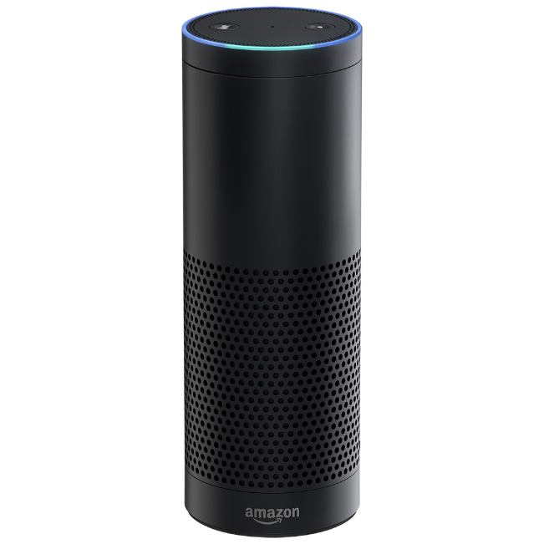

The Plan
Alexa – Can you hear me?
How hard can it be?
The Office

Slide 5
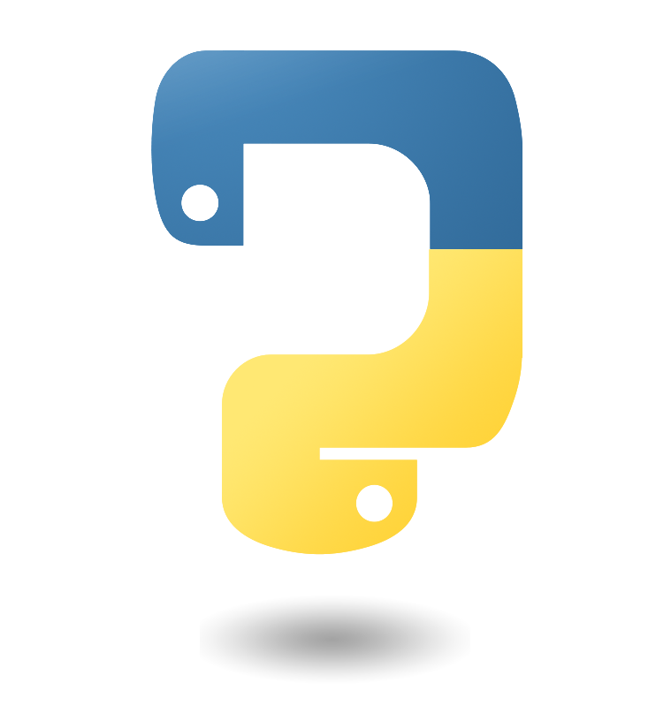
The Plan
Alexa – What’s the plan?
The Office

Slide 6


What’s Actually Needed:
More than I thought:
Amazon Dev Account
AWS
Python
This is where you create the app and add intents and sample utterances
This project required: IAM, Lambda, SQS, and API gateway
Flask-Ask, Boto3, Zappa

Slide 7

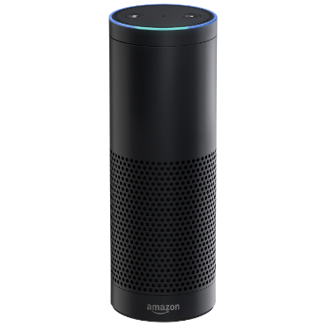

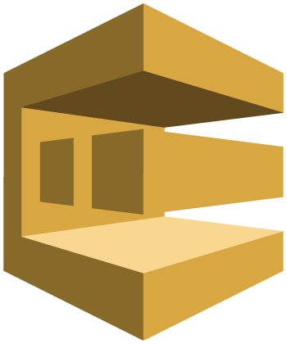
The Plan
Alexa – How does this work?
Amazon Voice Services
AWS Lambda
Alexa Enabled
Device
The Office
AWS API Gateway
AWS SQS
Function to be Executed

Slide 8
https://developer.amazon.com
Amazon Developer
Developer Account vs. User Account
Your Alexa devices have to be tied to an account, and your development apps will only be accessible devices tied to that account.

Slide 9
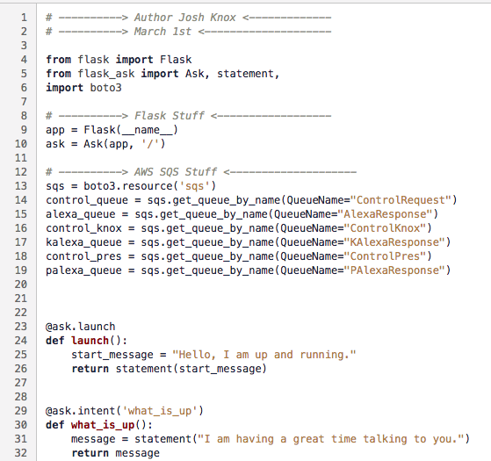
Flask-Ask
Python Package
by John Wheeler https://alexatutorial.com
Challenge:
Getting code to Lambda
Solution:
Zappa
https://blog.zappa.io/

Slide 10
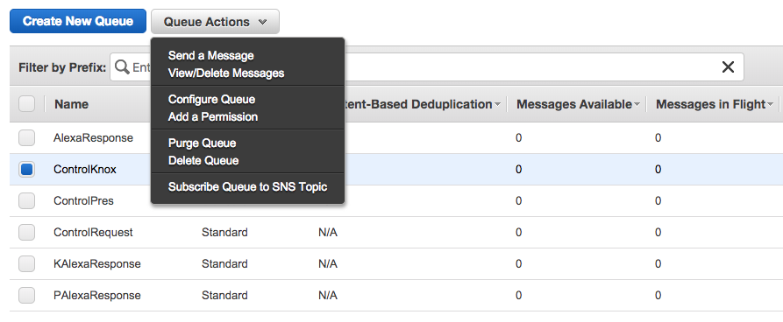
Flask-Ask
Python Package
by John Wheeler https://alexatutorial.com
Challenge:
How to ‘talk’ to remote code
Solution:
AWS SQS
AWSCLI
boto3

Slide 11
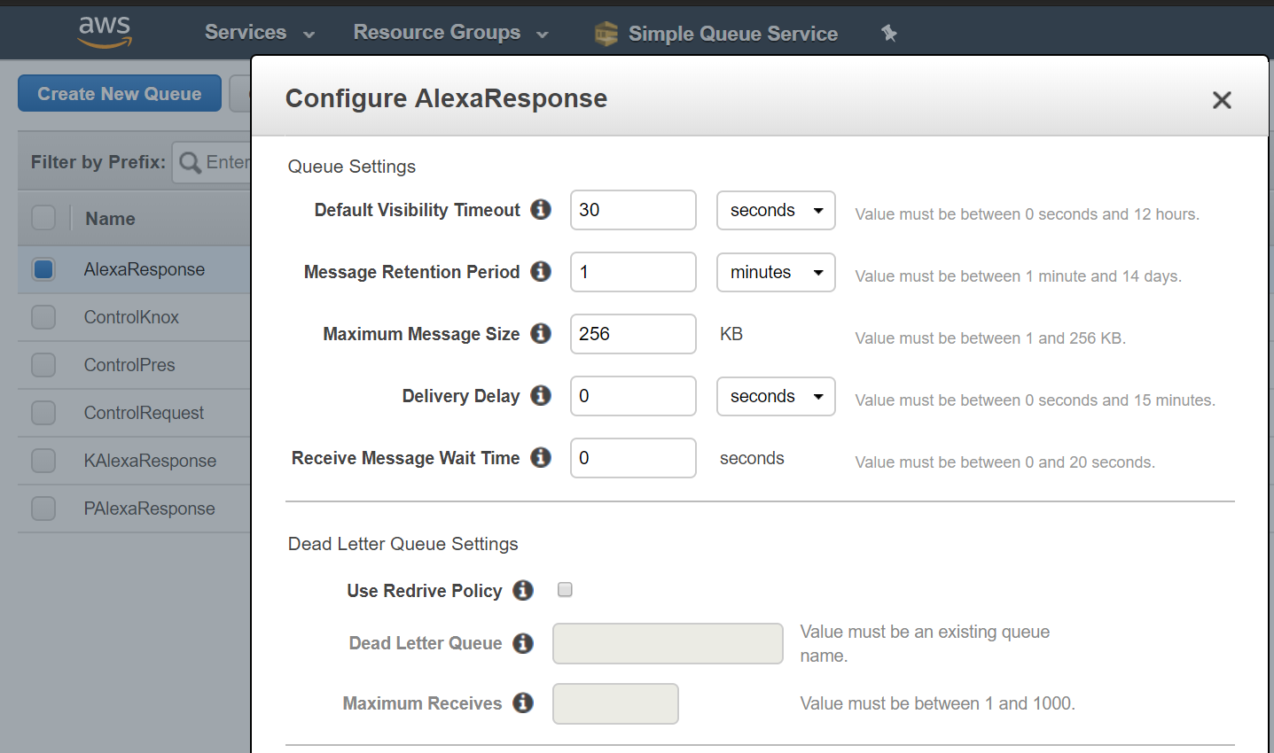
Flask-Ask
Python Package
by John Wheeler https://alexatutorial.com
Challenge:
How to ‘talk’ to remote code
Solution:
AWS SQS
AWSCLI
boto3

Slide 12
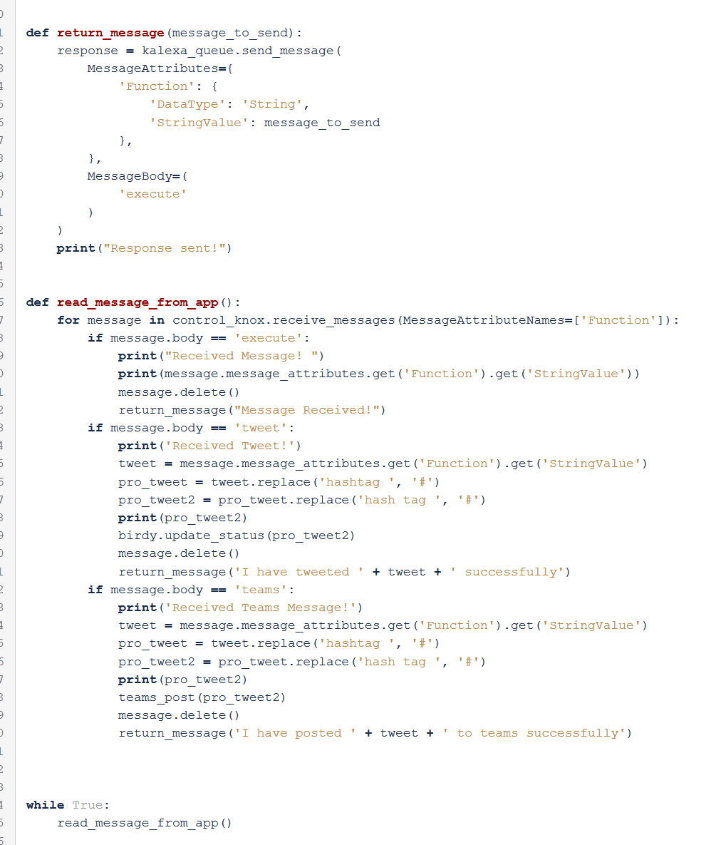
The Remote Code
AWSCLI
You will need to create an AWS user with permission to SQS.
AWSCLI must be configured with the access keys (and the region you are using SQS in)
Boto3 will handle auth with AWS

Slide 13
Questions?

